Slide 1
Hotel Bookings Cancellation Analysis
By Dixita Antala

Slide 2
BUSINESS PROBLEM
In recent years, City Hotel and Resort Hotel have seen high cancellation rates. Each hotel is now dealing with a number of issues as a result, including fewer revenues and less than ideal hotel room use. Consequently, lowering cancellation rates is both hotels’ primary goal in order to increase their efficiency in generating revenue and for us to offer thorough business advice to address this problem.
The analysis of hotel booking cancellations as well as other factors that have no bearing on their business and yearly revenue generation are the main topics of this report.

Slide 3
RESEARCH QUESTIONS
What are the variables that affect hotel reservation cancellations?
01
02
How can we make hotel reservations cancellations better?
03
How will hotels be assisted in making pricing and promotional decisions?

Slide 4
HYPOTHESIS
More cancellations occur when prices are higher.
When there is a longer waiting list, customers tend to cancel more frequently.
The majority of clients are coming from offline travel agents to make their reservations.

Slide 5
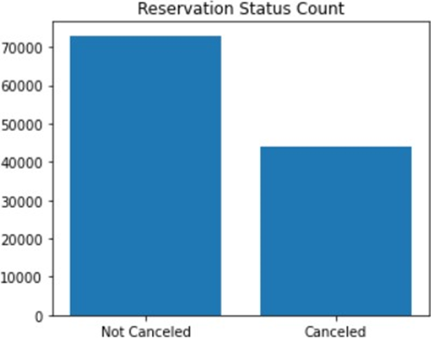
ANALYSIS AND FINDINGS - 1
The accompanying bar graph shows the percentage of reservations that are cancelled and those that are not. It is obvious that there are still a significant number if reservations that have nit been cancelled. There are still 37% of clients who cancelled their reservations, which has a significant impact on the hotels’ earnings.

Slide 6
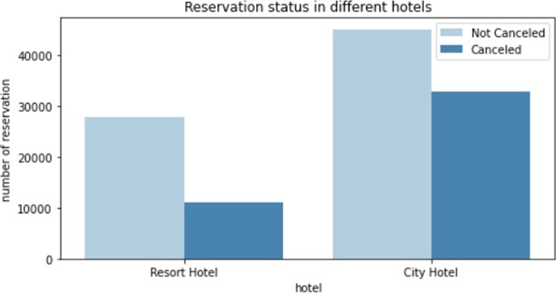
ANALYSIS AND FINDINGS - 2
In comparison to resort hotels, city hotels have more bookings. It is possible that resorts hotels are more expensive than those in cities.

Slide 7
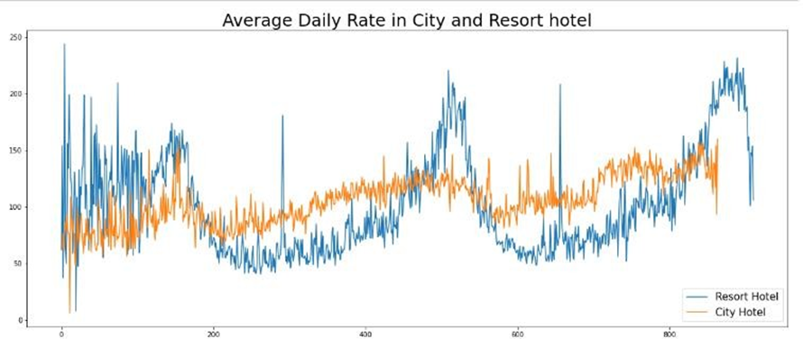
ANALYSIS AND FINDINGS - 3
The line graph shows that on certain days, the average daily rate for a city hotel is less than that of are sort hotel, and on other days, it is even less, It goes without saying that weekends and holidays may see a rise in resort hotel rates.

Slide 8
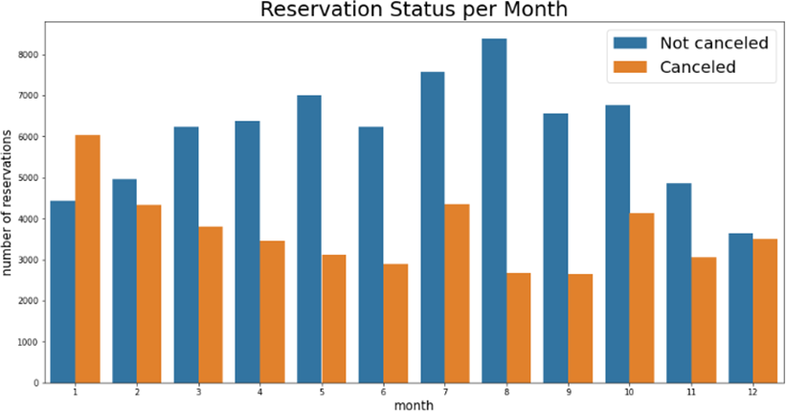
ANALYSIS AND FINDINGS - 4
We have developed the grouped bar graph to analyse the months with the highest and lowest reservation levels according to reservation status. As can be seen, both the number of confirmed reservations and the number of cancelled reservations are largest in the month of August, whereas January is the month with the most cancelled reservations.

Slide 9
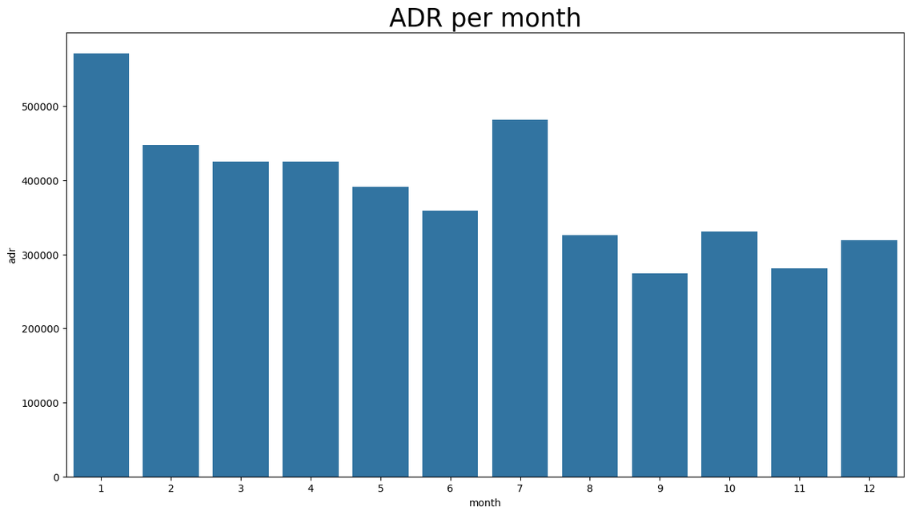
ANALYSIS AND FINDINGS - 5
The bar graph demonstrates that cancellations are most common when prices are greatest and are least common when they are lowest. Therefore, the cost of the accommodation is solely responsible for the cancellation.

Slide 10
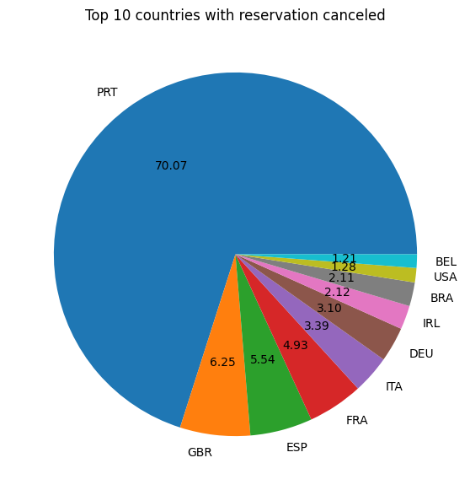
ANALYSIS AND FINDINGS - 6
The pie chart shows which country has the highest reservations cancelled. The top country is Portugal with the highest number of cancellations.

Slide 11
ANALYSIS AND FINDINGS - 7
The table shows the areas from where guests are visiting the hotels and making reservations, whether it is coming from Direct or Groups, Online or Offline Travel Agencies. We can see around 47% of clients come from online travel agencies, whereas 27% come from groups. Only 4% of clients book hotels directly by visiting them and making reservations.
market_segment
Online TA 0.469696 Groups 0.273985
Offline TA/TO 0.187466 Direct 0.043486
Corporate 0.022151 Complementary 0.002038 Aviation 0.001178

Slide 12
SUGGESTIONS
Cancellation rates rise as the price dates. In order to prevent cancellations of reservations, hotels could work on their pricing strategies and try to lower the rates for specific hotels based on locations.They can also provide some discounts to the consumers.
As the ratio of the cancellations and not cancellation of the resort hotels is higher in the resort hotel than the
city hotels. So the hotels should provide a reasonable discount on the room prices on weekends or on holidays.
In the month of January, hotels can start campaigns or marketing with a reasonable amount to increase the revenue as the cancellation is the highest in this month.
They can also increase the quality of the hotels and their services mainly in Portugal to reduce the cancellation rate.

Slide 13
Thank you!

